Slide 1
Intensity

Slide 2
If you throw a stone into a pond, it will produce a series of spreading ripples.
These ripples move away from the point where the stone landed, and as they move further from this point, their amplitude decreases.
This is because the energy of the wave is spread over a greater area.

Slide 4
Intensity of sound
As you move further from a sound source, the apparent loudness of the sound decreases.
The sound will spread spherically from the point source.
When the distance from this point is doubled, the sound will be spread over four times the area.

Slide 5
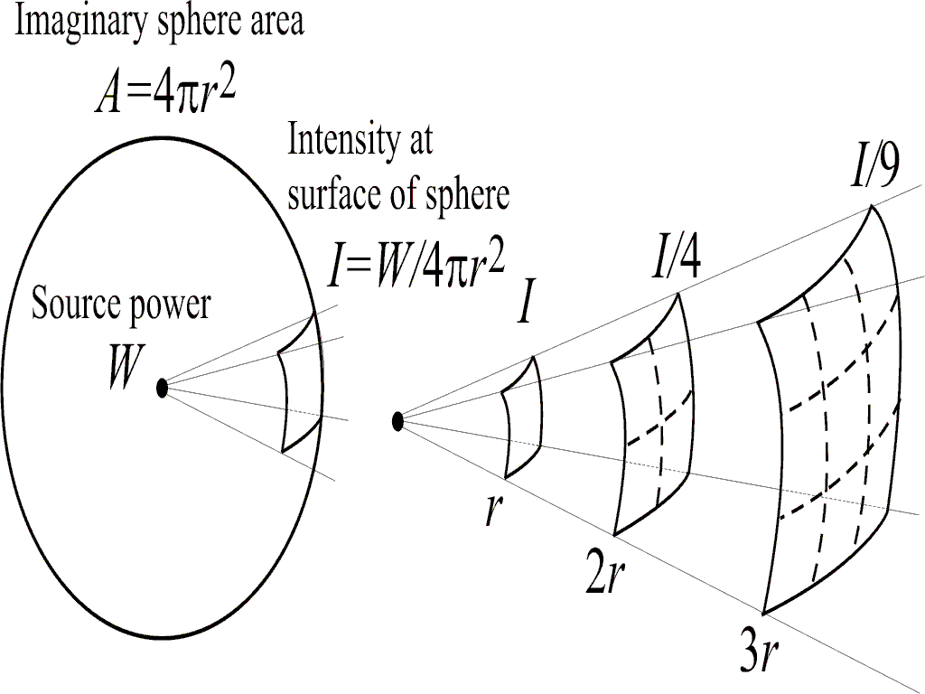

Slide 6

The relationship
$$I∝\frac{1}{r^{2}}$$

Slide 7
Example 1
Mia hears a siren sounding 10m away. By what factor would the intensity of the sound from the siren change if Mia was to move to a distance of 50m from the siren?

Slide 8
Example 2
An ambulance started its siren 200m after leaving the scene of an accident. After a short time the intensity of the sound was measured as being a quarter of the original. Assuming the volume of the siren hasn’t changed, how far away was the ambulance when the intensity was measured?

